Slide 1
Mobile Judge 9.0
Team Members: Kyle Ryan and Mario Fidalgo Product Owner: Masoud Sadjadi
Instructor: Masoud Sadjadi School of Computing and Information Sciences Florida International University
Final Presentation
Summer 2017
Notes:
7 seconds.( I will select 2 best slides (i will give them extra points and students will present for CIS committee)
Greet your audience, thank them for attending your presentation, introduce yourself, introduce your project, introduce your team members, and quickly indicate what each of you did in a high-level manner, and put more emphasis on your part/contribution.

Slide 2
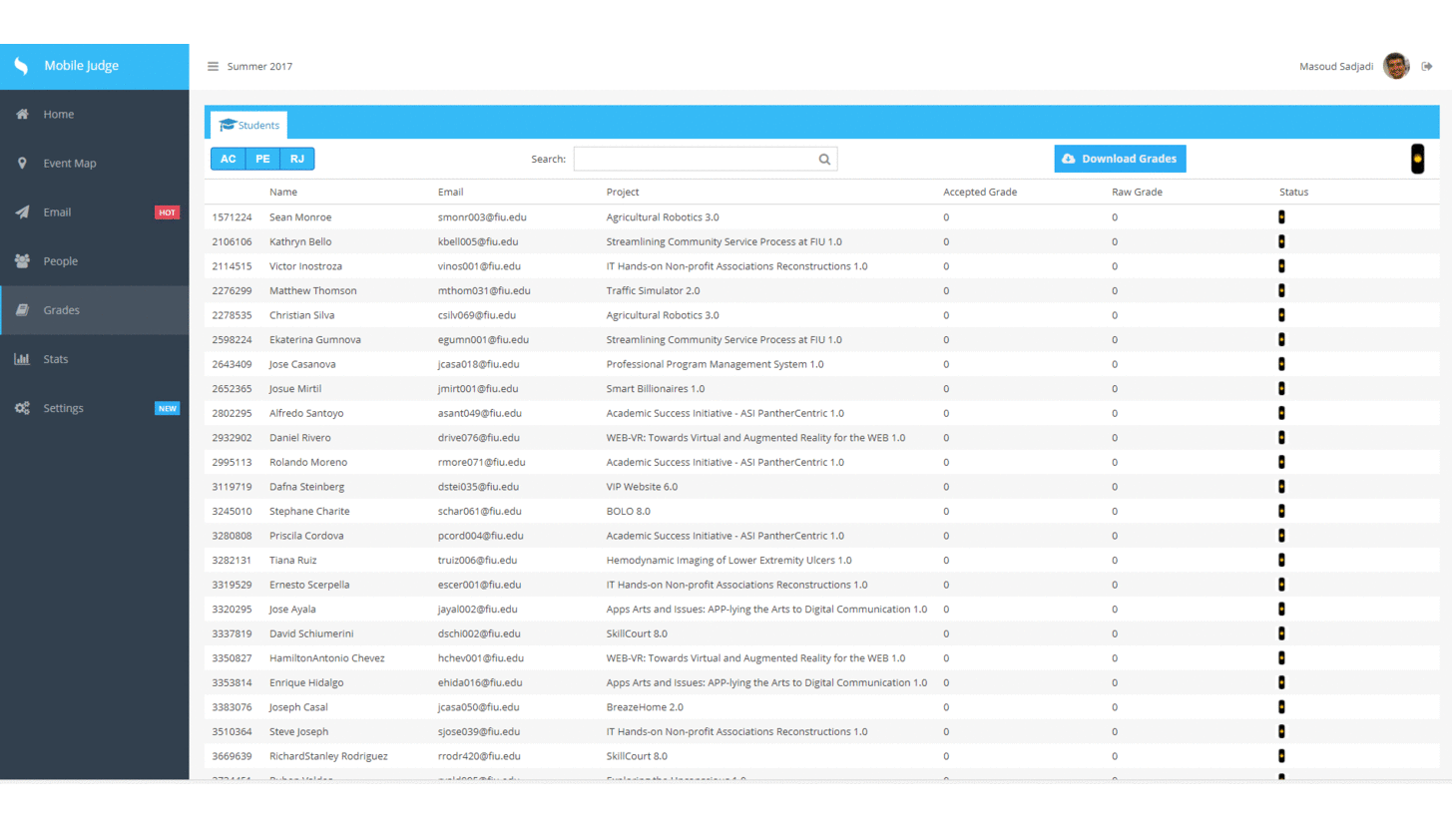
Project definition
Notes:
10 seconds.
Introduce the problem that the whole project (in all versions) tackles with GIF or screenshot.

Slide 3
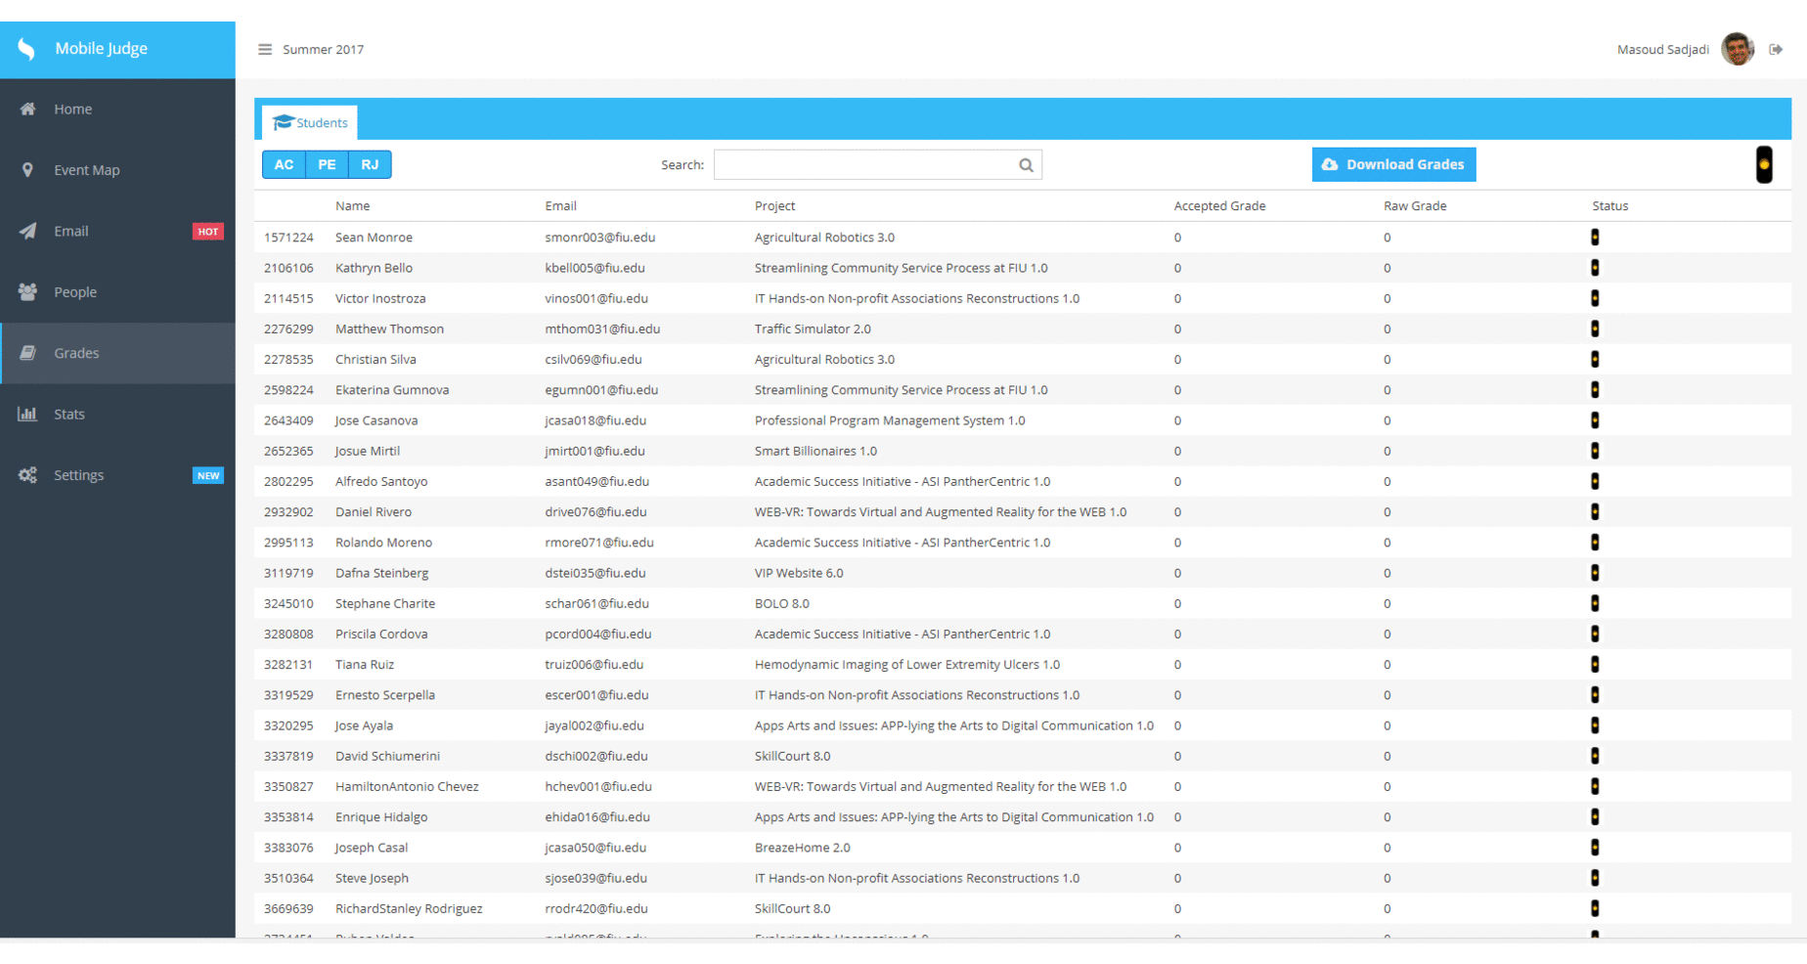
Project definition
Notes:
20 seconds.
Introduce the problem that the your project (in new version) tackles with GIF or screenshot.

Slide 4
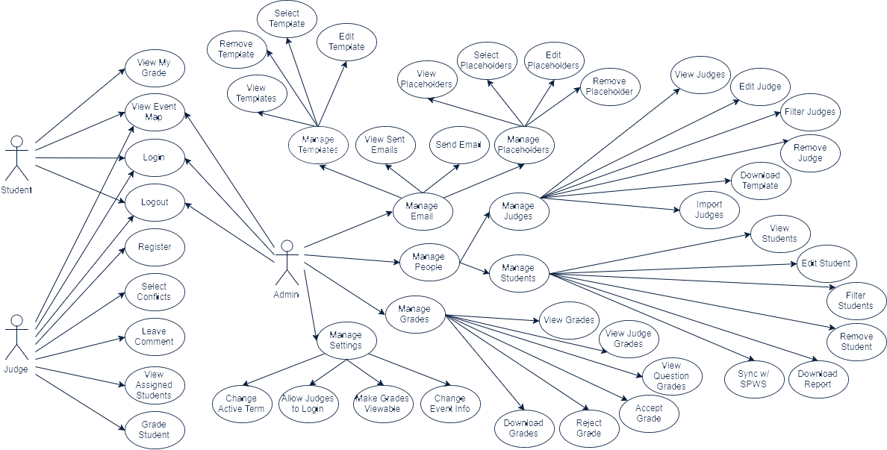
Requirements: Use Cases
Notes:
5 seconds
Show the Use Case Diagram for the whole project. Highlight your use cases.

Slide 5
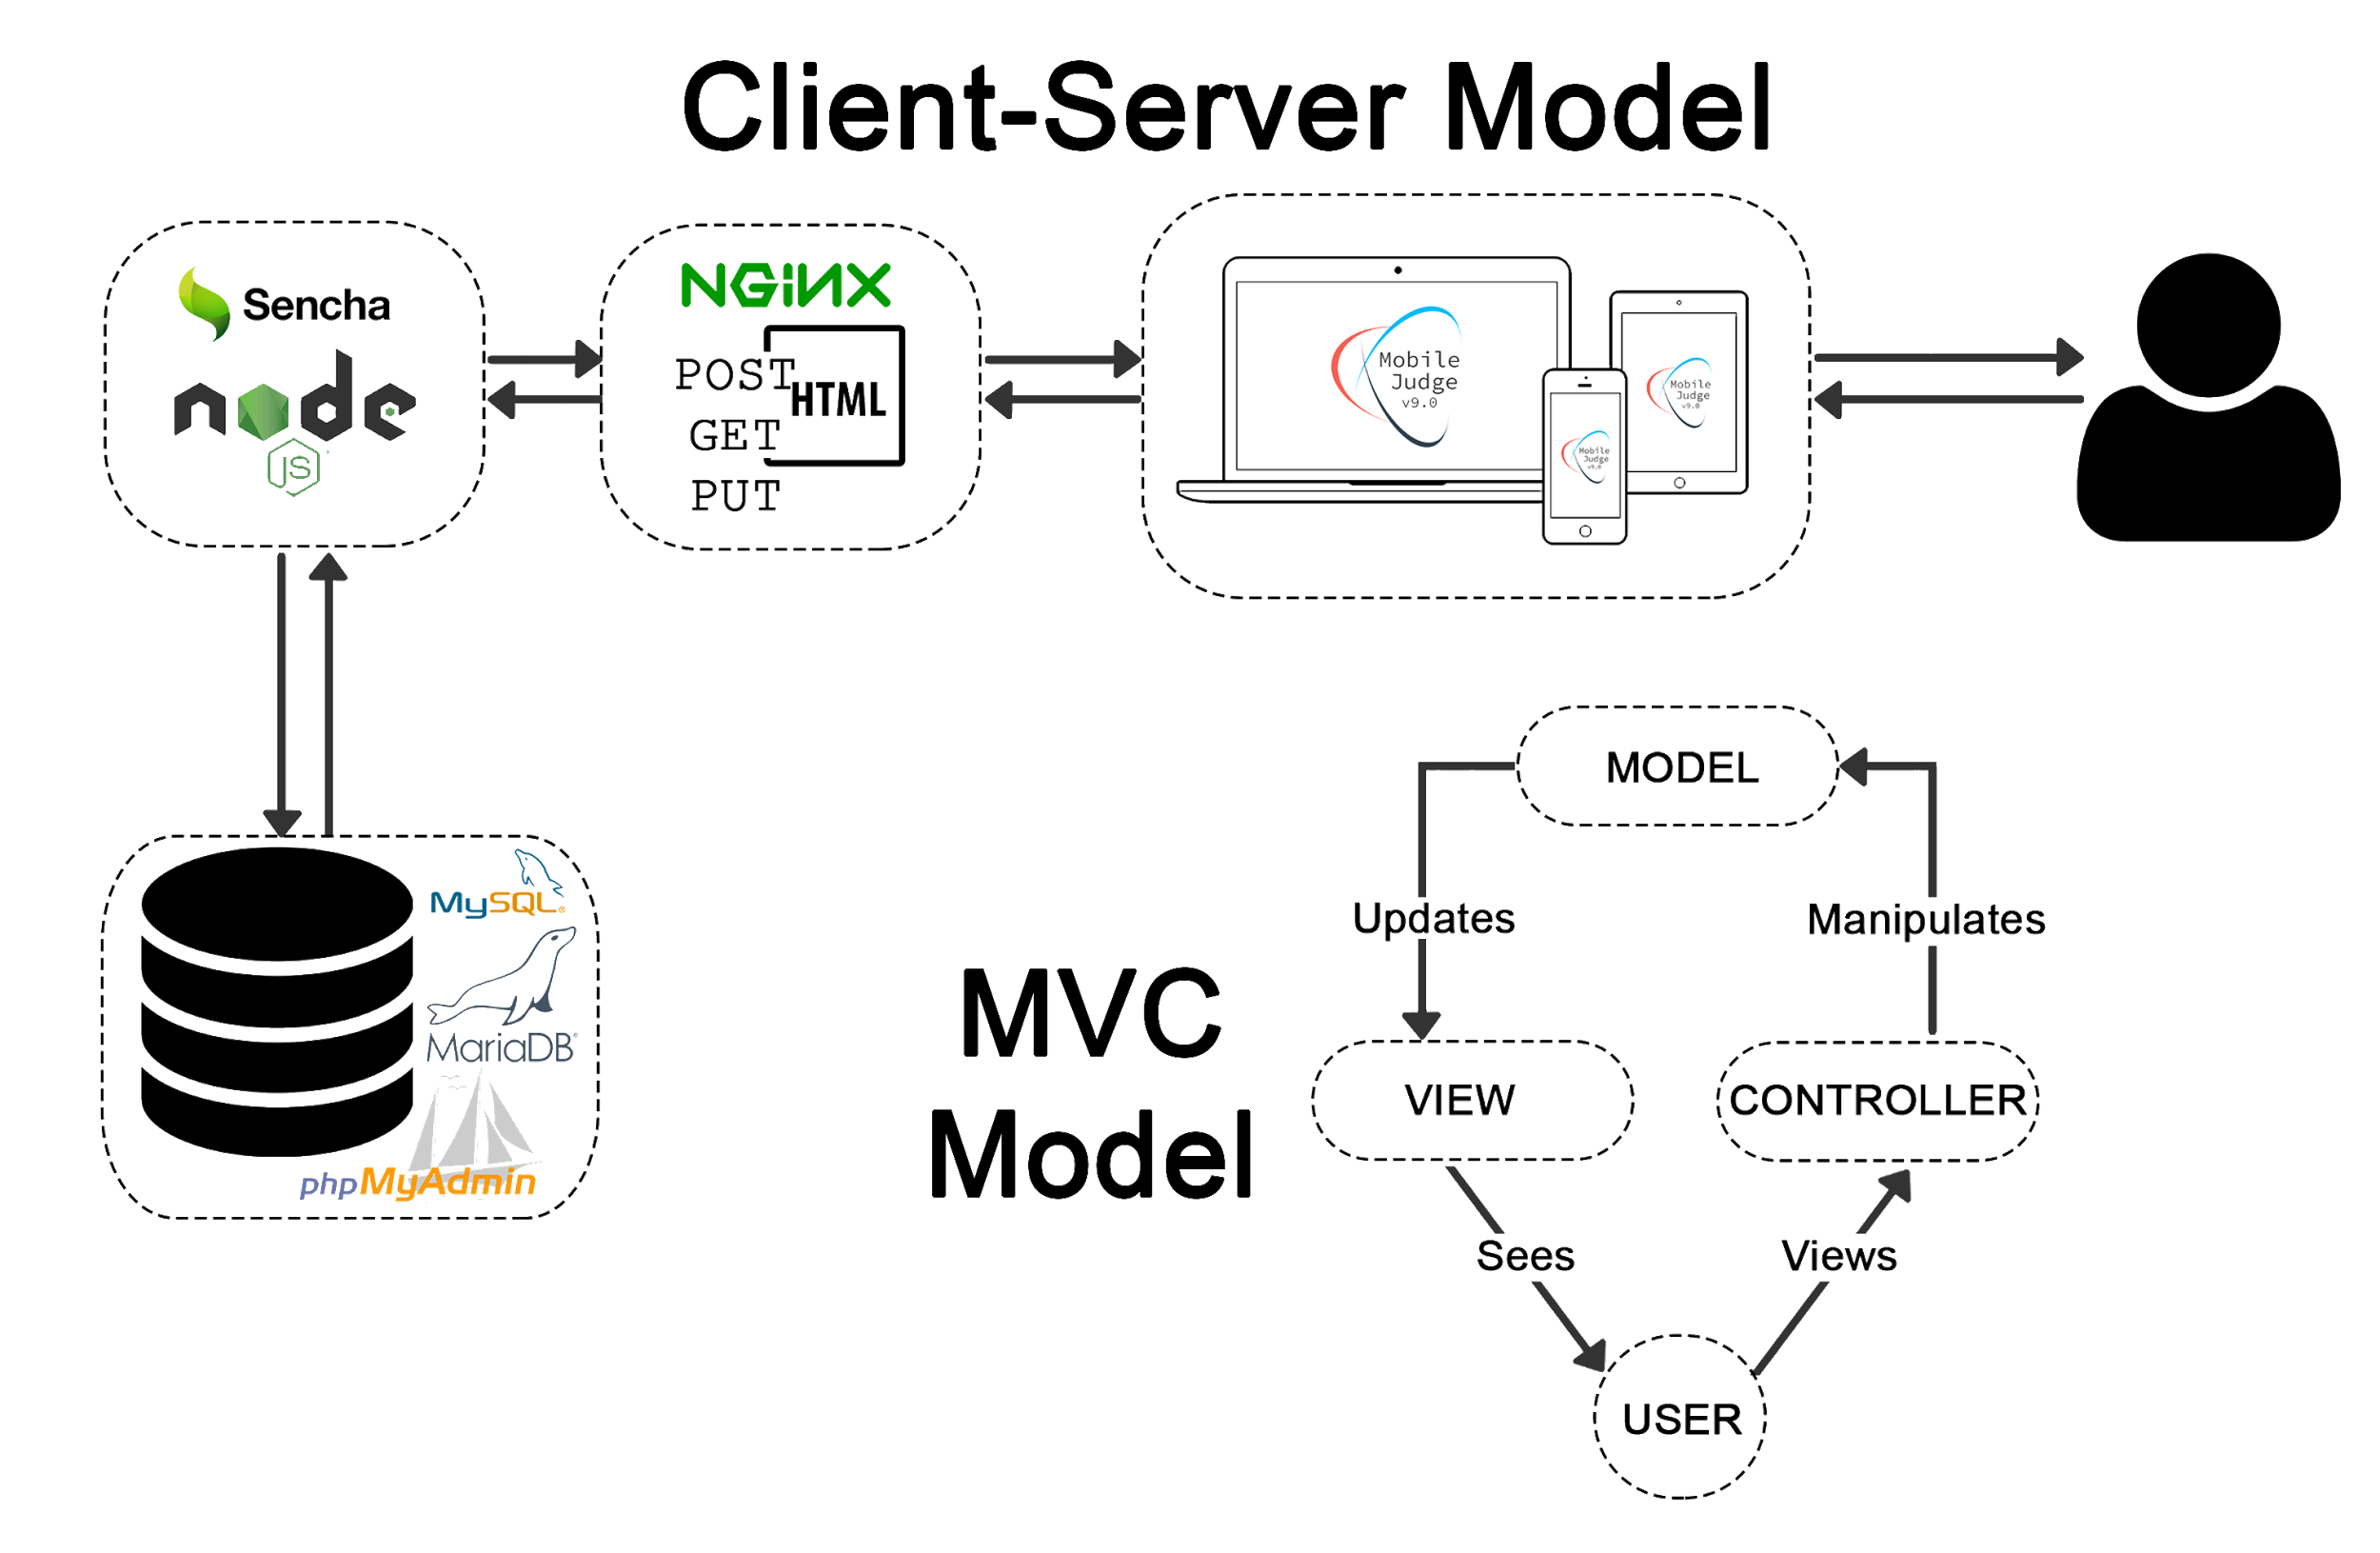
System Design: Architecture
Notes:
20 seconds
System design: Highlight the parts that you contributed to them.
1. System decomposition; identify the architecture patterns used
2. System deployment – h/w and s/w requirements

Slide 6
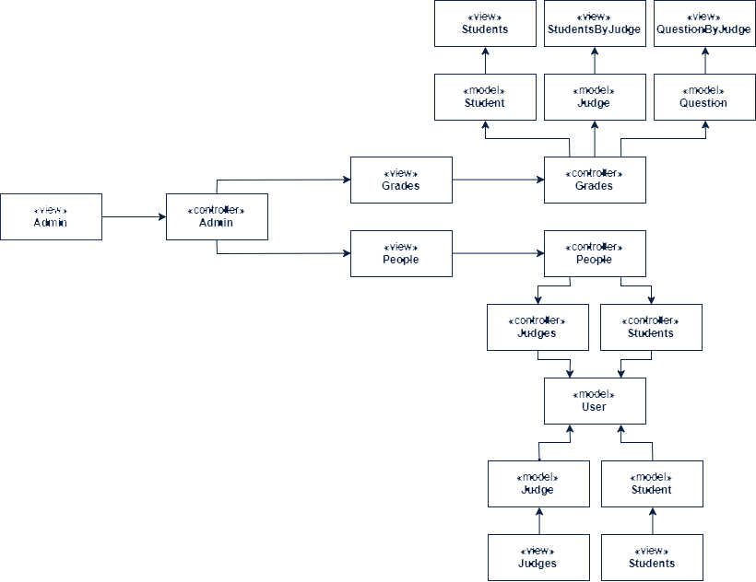
Minimal Class Diagram
Notes:
10 seconds.Minimal class diagram. Highlight the classes that you created/modified
Identify the design patterns used (one or more slides).

Slide 7
User Stories
Mario Fidalgo
#647 - Allow student fields to be edited
#648 - Allow Judge fields to be edited
#649 - Download/Export Accepted Grades
#650 - Bug: Fix issue with Sync
#655 - Add grades tab
#656 - Add approve and reject buttons
#658 - Add Combobox for Projects in Students
#659 - Bug: Fix issue with Location edit
#666 - Add a Judge view for each Judge
#665 - Add a Judges view for each student
#669 - Add Filter Buttons with Checkbox to Grades
Kyle Ryan
#651 - Add new filter button to Students
#652 - Add new filter button to Judges
#653 - Add downloadable template for Judges
#654 - Modify Import function
#660 - Deploy changes to MJ-Dev
#661 - Modify Judges Registration Form Descriptions
#662 - Add visual cue for filter buttons
#663 - Add combobox in students/judges tab for status
#664 - Add Students View to Grades
#667 - Expand descriptions for Registration Form
Notes:
5 seconds.
List the user stories that you worked on them.(put in order of importance). Stay focused on the parts that you have been working.

Slide 8
User Story #664 - Add Students View to Grades
Creating the view to show all active student’s grades
Each student record required displaying:
Name
Email
Project
Accepted Grade
Raw Grade
Status
This is the base view that will include features such as:
Download Grades
Filter by: Accepted, Pending, Rejected
Search bar
Sort by any field
Global Status Changer
Notes:
60 seconds
The tile of user story
The most important user story you worked on it. You have to describe this one very well and be proud of that.
Please present and show the complexity of your work, code, algorithms, and technical challenges and technologies you have used. (you could use screenshot if you want. Visual presentations are better than text presentation)
Go into the details of the most important/significant tasks using bullet lists or visual graphs or state chart diagram
Sequence Diagram for this user story is mandatory (in another separate page if required)
Demo using screenshots or GIF (in another separate page if required)

Slide 9
Students Grade View Code Snippet
columns: [
{
xtype: 'gridcolumn',
width: 75,
dataIndex: 'studentId',
id:'studentIdxColumn',
hideable: false,
text: '',
},
{
xtype: 'gridcolumn',
dataIndex: 'fullName',
id:'studentNameColumn',
text: 'Name',
flex: 1,
},
{
xtype: 'gridcolumn',
dataIndex: 'email',
id:'studentEmailColumn',
text: 'Email',
flex: 1,
},
{
xtype: 'gridcolumn',
dataIndex: 'project',
id:'studentProjColumn',
text: 'Project',
flex: 2,
},
{
xtype: 'gridcolumn',
dataIndex: 'grade',
text: 'Accepted Grade',
id:'studentAgColumn',
flex: 1
},
{
xtype: 'gridcolumn',
dataIndex: 'rawGrade',
id:'studentRgColumn',
text: 'Raw Grade',
flex: 1
},
{
id: 'status',
xtype: 'actioncolumn',
text: 'Status',
flex: 1,
items: [
{
icon: '/resources/images/icons/Yellow.ico',
tooltip: 'Status',
handler: 'onStateChange'
}
],
]

Slide 10
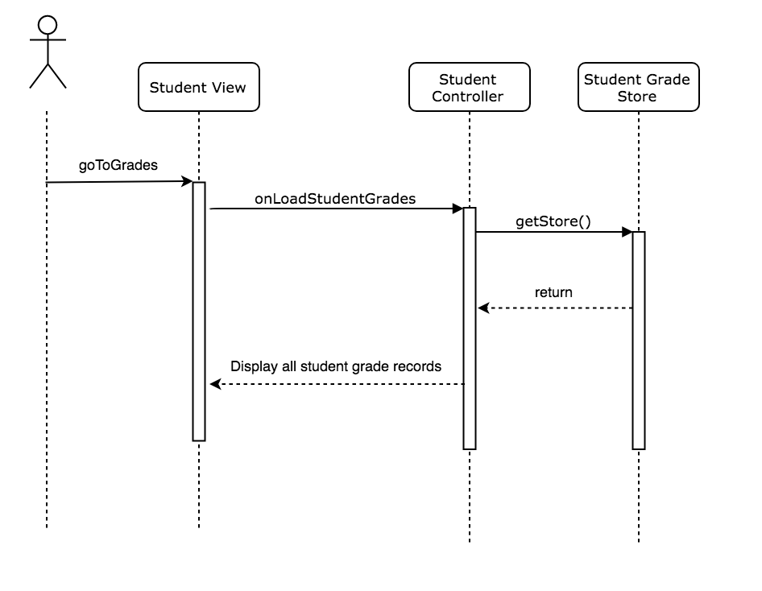
Student Grades View Sequence Diagram

Slide 11
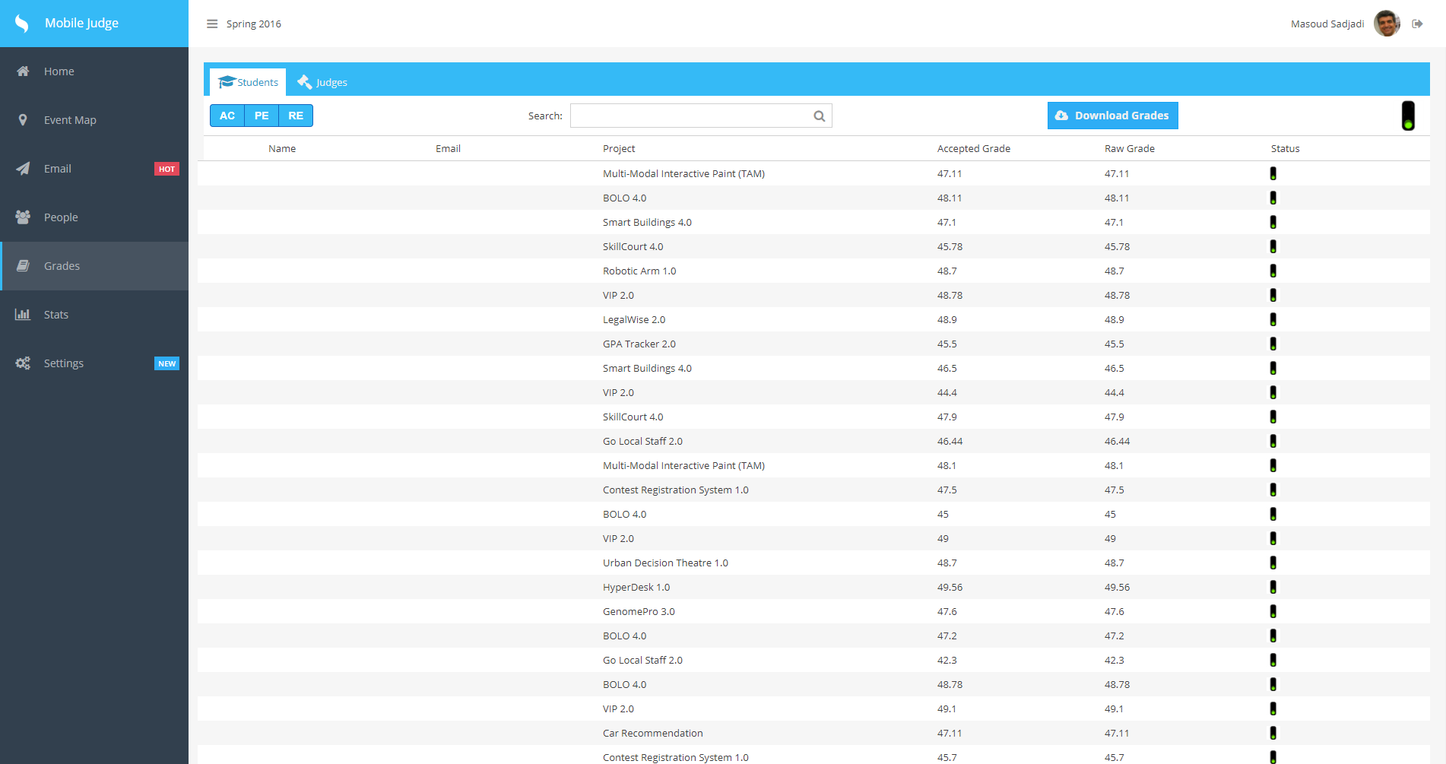
Student Grades View Screenshot

Slide 12
User Story #665 -Add Judges View for each Student
Each Student in the Grades tab when click will display a popup
The popup contains:
Student’s Name
Project
Grade
List of Judges assigned to student
The List of judges contain:
Judge’s Name
Accepted Grade
Raw Grade
Status
loadSecondViewData: function (data) {
var me = this;
Ext.Ajax.request({
url: '/api/second_view',
success: function (response) {
var data = JSON.parse(response.responseText)
Ext.getStore('studentDetailData').loadData(data);
var average = me.getAverage(data);
Ext.getCmp('gradeLabel').setText(average);
me.changeIconSecondView();
},
failure: this.updateError,
jsonData: data,
disableCaching: true,
method: 'POST'
});
},
Notes:
20 seconds
The tile of user story
Please present and show the complexity of your work, code, algorithms, and technical challenges and technologies you have used. (you could use screenshot if you want. Visual presentations are better than text presentation) - Go into the details of the most important/significant tasks using bullet lists or visual graphs or state chart diagram - Demo using screenshots or GIF (in another separate page if required)
Sequence Diagram for this user story is optional

Slide 13
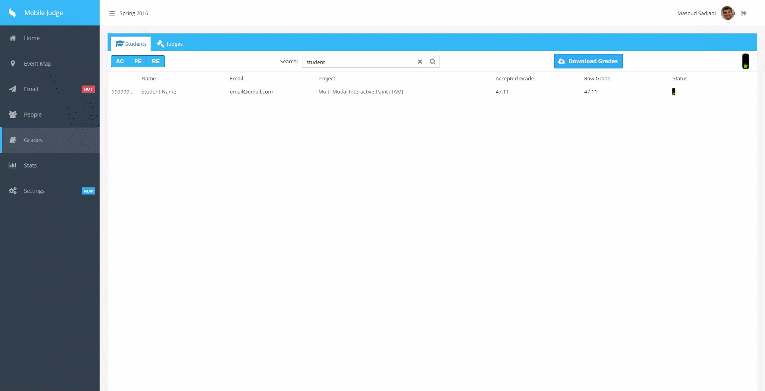
Add Judges View for each Student

Slide 14
User Story #666 - Add question view for each judge’s grade
Each Judge assigned to the Student in the Judge's view popup when clicked will display a Questions view
The Questions View contains:
Student’s Name
Judge’s Name
Project
Grade
List of Questions
Each question contains:
Question
Grade
Comment
Status
loadThirdViewData: function (data) {
var me = this;
Ext.Ajax.request({
url: '/api/third_view',
success: function (response) {
var data = JSON.parse(response.responseText)
Ext.getStore('judgeGrades').loadData(data);
var sum = 0;
$("#gradeThirdLabel").text(0);
data.forEach(function (item) {
if (item.accepted == "Accepted") {
sum = item.grade + sum;
$("#gradeThirdLabel").text(sum);
}
})
$("#judgeThirdLabel").text(data[0].judge);
$("#studentThirdLabel").text(data[0].student);
$("#projectThirdLabel").text(data[0].projectName);
me.changeIconThirdView();
},
failure: this.updateError,
jsonData: data,
disableCaching: true,
method: 'POST'
});
},
Notes:
20 seconds
The tile of user story
Please present and show the complexity of your work, code, algorithms, and technical challenges and technologies you have used. (you could use screenshot if you want. Visual presentations are better than text presentation) - Go into the details of the most important/significant tasks using bullet lists or visual graphs or state chart diagram - Demo using screenshots or GIF (in another separate page if required)
Sequence Diagram for this user story is optional

Slide 15
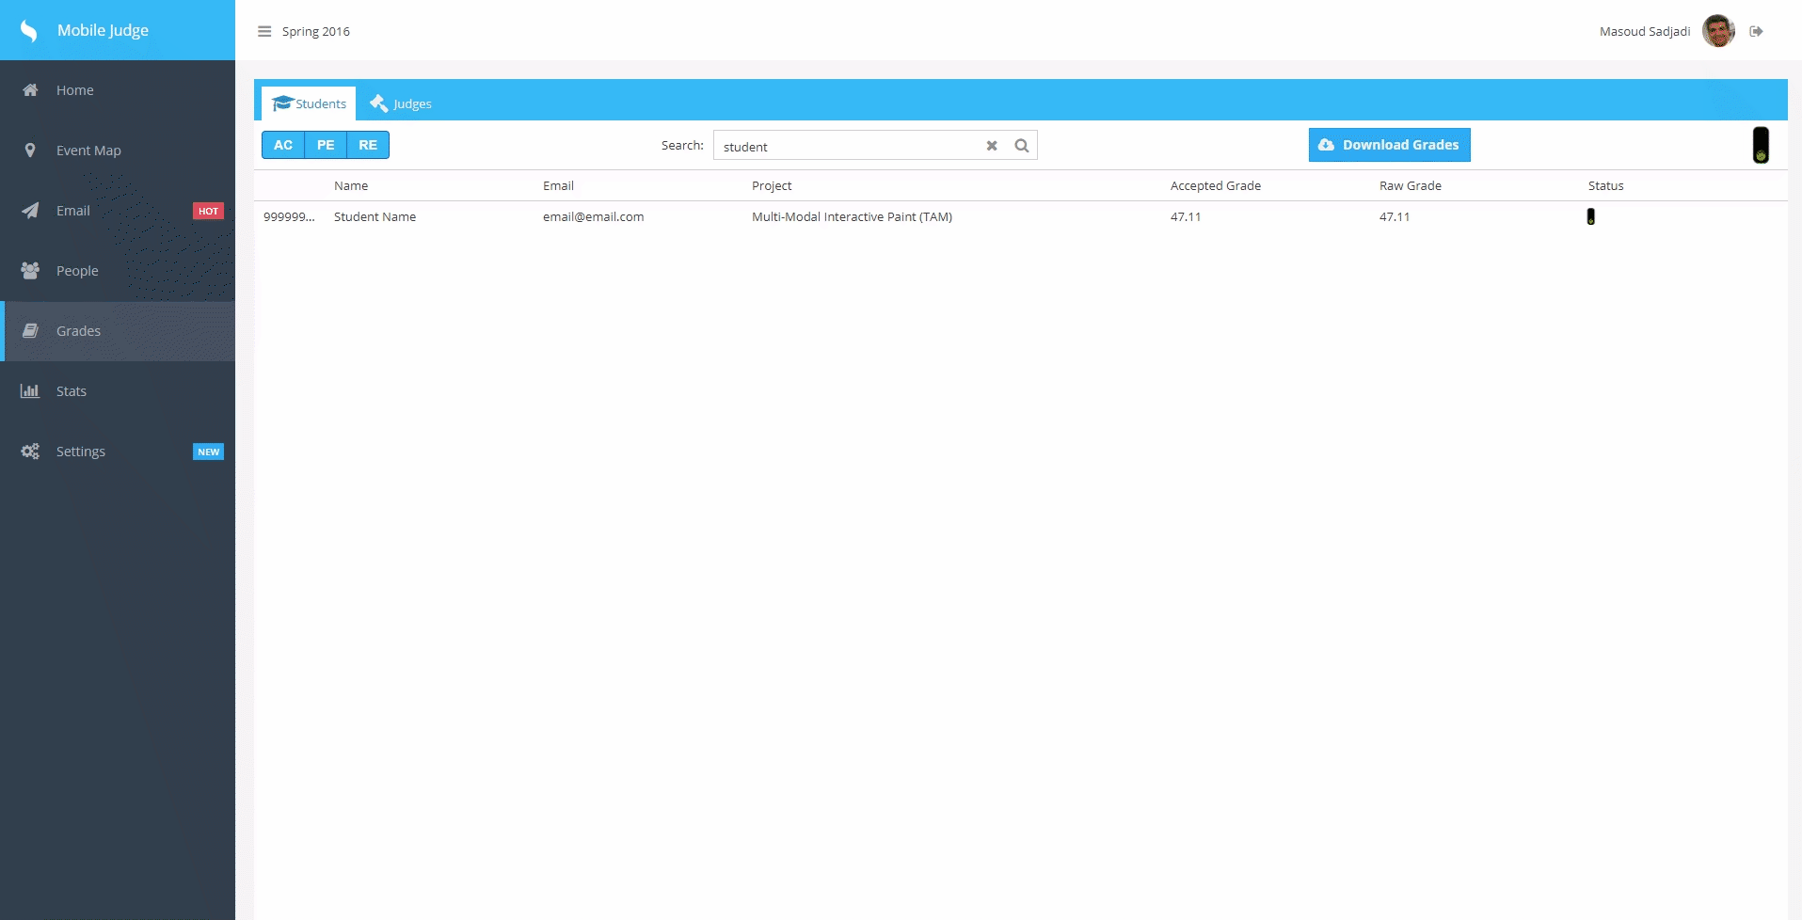
Add Question View for each Student

Slide 16

User Story #656 - Add accept, pend, reject button for each student
Each student in the Student’s Grade View has a traffic light icon
The Icon cycles through three options:
Accepted = Green
Pending = Yellow
Rejected = Red
if(record.get('rejected') == true){
this.items[0].tooltip = 'Rejected';
this.items[0].icon = '/resources/images/icons/Red.ico';
red = true;
}
if (green && red && yellow) {
this.items[0].tooltip = 'Accepted|Pending|Rejected';
this.items[0].icon = '/resources/images/icons/RedYellowGreen.ico';
}else if(green && red) {
this.items[0].tooltip = 'Accepted|Rejected';
this.items[0].icon = '/resources/images/icons/RedGreen.ico';
}else if(green && yellow) {
this.items[0].tooltip = 'Accepted|Pending';
this.items[0].icon = '/resources/images/icons/YellowGreen.ico';
}else if(yellow && red) {
this.items[0].tooltip = 'Pending|Rejected';
this.items[0].icon = '/resources/images/icons/RedYellow.ico';
}
}
},
renderer: function (value, metadata, record) {
if(record.get('accepted') != null){
var green = false;
var red = false;
var yellow = false;
if (record.get('pending') == true) {
this.items[0].tooltip = 'Pending';
this.items[0].icon = '/resources/images/icons/Yellow.ico';
yellow = true;
}
if (record.get('accepted') == true) {
this.items[0].tooltip = 'Accepted';
this.items[0].icon = '/resources/images/icons/Green.ico';
green = true;
}
Notes:
20 seconds
The tile of user story
Please present and show the complexity of your work, code, algorithms, and technical challenges and technologies you have used. (you could use screenshot if you want. Visual presentations are better than text presentation) - Go into the details of the most important/significant tasks using bullet lists or visual graphs or state chart diagram - Demo using screenshots or GIF (in another separate page if required)
Sequence Diagram for this user story is optional

Slide 17
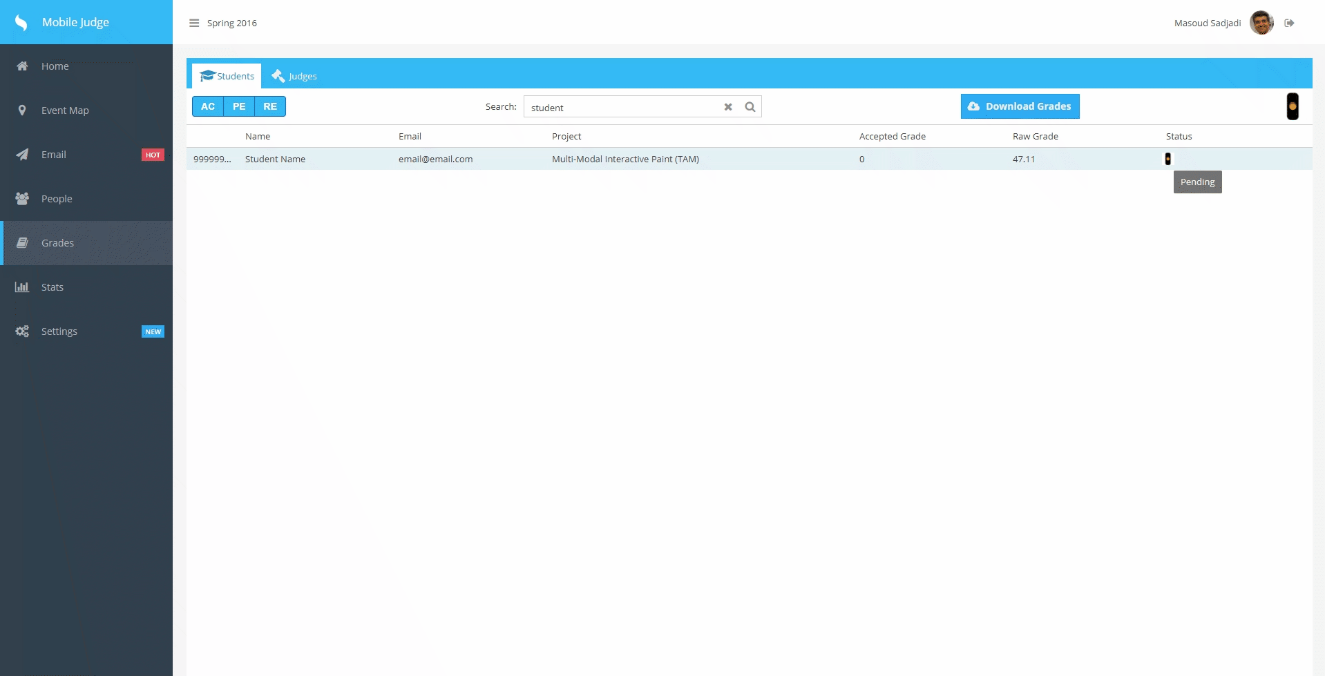
Approve, pend, reject grade button for each student

Slide 18
User Story #649 - Download Student Accepted Grades
The Student’s Grade View contains a Download Grade button
The functionality downloads all the student’s grades that meet the filters applied
The feature also takes into account the current sort applied to the grid
{
ui: 'soft-blue',
glyph: '',
iconCls: 'x-fa fa-cloud-download',
text: 'Download Grades',
handler: 'onExportGradeReport'
}
Ext.Ajax.request({
url: linkURL,
method: 'GET',
success: function (response, options) {
JSONToCSVConvertor(Ext.decode(response.responseText), "Student Grade Report", true);
}
});
Notes:
20 seconds
The tile of user story
Please present and show the complexity of your work, code, algorithms, and technical challenges and technologies you have used. (you could use screenshot if you want. Visual presentations are better than text presentation) - Go into the details of the most important/significant tasks using bullet lists or visual graphs or state chart diagram - Demo using screenshots or GIF (in another separate page if required)
Sequence Diagram for this user story is optional

Slide 19
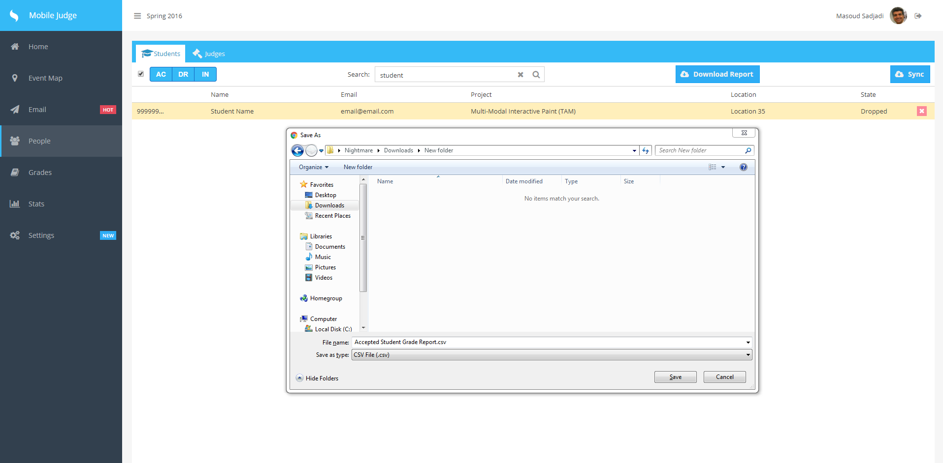
Download Student Grade Report

Slide 20
Test Case on Download Grade
Test case ID: MJ-649-01 (Sunny Day)
Description/Summary of Test: Download Student’s Grades for Active Semester
Precondition:
Admin is currently logged into Mobile Judge account
Currently on the grades side tab
Viewing the students gridview
Clicks download grades
Expected Results: Popup requesting Admin to save or open CSV file of all the student’s grade who are active.
Actual Result: A popup displayed once Download Grades was clicked, and the file contained only the active semester’s grades.
Status (Fail/Pass): Pass
Test case ID: MJ-649-02 (Rainy Day)
Description/Summary of Test: Download Student’s Grades for Active Semester
Precondition:
Admin is currently logged into Mobile Judge account
Currently on the grades side tab
Viewing the students gridview
Clicks download grades, but no filters selected
Expected Results: No download will occur since no record will display due to no filters being selected.
Actual Result: An alert popup with saying “No Filters Selected!”
Status (Fail/Pass): Pass
Notes:
10 seconds
A description of verification process and Test Suites and Test Cases for one of the use cases.
1 One sunny day and one rainy day for the implemented use cases (one or more slides).
2 Automated test scripts for the implemented use cases (if any) (one or more slides).

Slide 21
Summary
Mobile Judge is currently in version 9.0, and will continue to improve throughout the years to provide the best user experience possible for the upcoming showcases. This version was mainly focused on the backend for the use of the administrator to ease the workload required for managing the showcases. The software development cycle used allowed for the improvement of Mobile Judge to be as optimal as possible and provide a professional work experience.
Notes:
10 seconds
Summarize your contribution, mention your effort for Scrum, Mingle, Github, Google Drive Documentation and minutes
Include your contact information
Ask if anyone has any questions for you.
Thank your audience

Slide 22
Questions?
Thank You!
Contact Info
Kyle Ryan - kryan014@fiu.edu
Mario Fidalgo - mfida003@fiu.edu

